Slide 1

Online Encounter 24
Notes:
ENCOUNTER 24
REVIEW STUDENT PROGRESS
Check for last Encounter attendance.
Check for last Speaking Center attendance and time spent.
Check that Lesson 3 has been completed.
Prepare general comments on Student attendance, study habits, and overall progress.
VIDEO SUMMARY
Marco, Khae, and Aanya go to the Big Boss to make their pitch, but Todd tells him about his proposed product first, and they realize he has stolen their idea. They decide the best revenge is to think of a new, even better idea.
At the restaurant, Nadi is going to announce the new head chef. Everyone speculates that it will be Sofi, and Diego will be named head waiter. They are surprised when Nadi introduces Renzo, a newcomer, as head chef. Sofi is now prep cook, and Diego is a waiter. Sofi is frustrated when Renzo announces he is remaking the entire menu.
Shen helps Paz move her couch, and Li Li is jealous that Shen is paying attention to Paz. Shen uses a map app to get directions to his agent Marti’s office. The app is very confusing, but does get him to Marti’s office in the end.
READING SUMMARY
In the first reading, a woman named Louisa texts her roommate because she cannot find her notebook. After Louisa explains everywhere she went the previous day, she realizes that she has left the notebook in her car.
The second reading is an invitation to a birthday party. The host describes the different foods that will be served at the party and asks that no presents be given. There are also driving directions to the party’s location.
AUDIO SUMMARY
A commercial advertises a concert series. The performers, Annie Aster and the Four-Woman Band, are briefly described. Concert times, ticket ordering information, and other concert details are included in the commercial.
VOCABULARY
Can name a limited range of common buildings and dwelling places (condo; hospital; library; mall; station)
Can name very common public places in a city (drug store; hospital; library; mall; pharmacy; station)
Can use basic language related to using a map (destination; Go over…; Go straight; Go two blocks; Turn right/left; Turn right/left on Bank Street; Walk across…; Walk along …)
GRAMMAR
Can express basic personal intentions using going to (My boss is going to hire new people for the restaurant.)
Can talk about past events using common regular/irregular past simple forms (The employee listened to the Big Boss talk.)
SPEAKING
Can express basic intentions with simple time markers (I am going to make soup today.)
Can ask for and give directions referring to a map or plan (Can you give me directions?)

Slide 2

Encounter 24
Introductions
Your teacher
My name is .
Now please introduce yourself.
Notes:
INSTRUCTIONS
This is a warm-up activity and should not be assessed.
Introduce yourself to the Students. Then ask each individual Student what his/her name is. Tell the Students:
Hello. My name’s _______. What’s your name?
Sample Responses: My name’s _______./My name is _______.
TEACHING TIPS
Ask the Students about their study habits. (e.g., Have you finished your Speaking Center Lessons? How about your Student Manual or Digital Book?)
Check for IT issues.

Slide 3
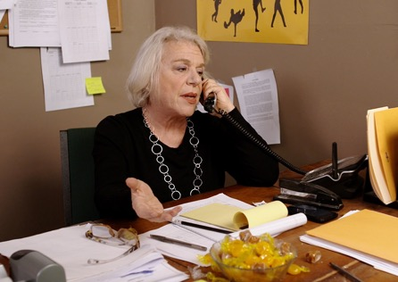
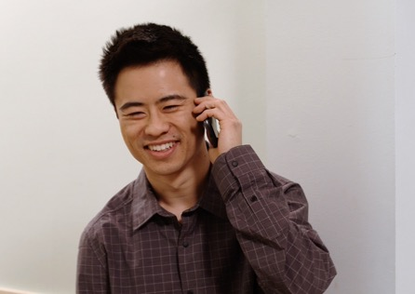
Part 1.0: Warm-Up
Who can you see in these pictures?
Marti and Shen
Notes:
1.1 Marti and Shen (5 min)
Allow one minute for this slide.
OBJECTIVE
To help the Students relax and start thinking in English
INSTRUCTIONS
#1. Have a Student read the question. [Who can you see in these pictures?]
#2. Encourage the Students to answer.
#3. Reveal the answer. [Marti and Shen]

Slide 4
Part 1.0: Warm-Up
Where are they?
What’s happening in the pictures?
What are they talking about?
Notes:
1.1 Marti and Shen
Allow four minutes for this slide.
INSTRUCTIONS
#1. Have a Student ask the first question. [What’s happening in the pictures?]
Call on another Student to answer the question.
#2. Have a Student ask the second question. [Where are they?]
Call on another Student to answer the question.
#3. Have a Student ask the third question. [What are they talking about?]
Call on another Student to answer the question.
ANSWER KEY (Sample Answers)
1. Marti and Shen are talking on the phone.
2. Shen’s in his apartment, and Marti’s at her office.
3. They are talking about what kind of building Shen lives in and directions to Marti’s office.

Slide 5
Part 2.0: Target Language
Activity 2.1: Context Creation
What other places do people live in?
What are other buildings you can find in a city?
in an apartment
a house
Where does Shen live?
a library and a store
Notes:
2.1 What’s around Town? (5 min)
Allow one minute for this slide.
OBJECTIVES
Can name a limited range of common buildings and dwelling places (condo; hospital; library; mall; station)
Can name very common public places in a city (drug store; hospital; library; mall; pharmacy; station)
INSTRUCTIONS
#1. Have a Student read the question. [Where does Shen live?]
#2. Encourage the Students to answer.
#3. Reveal the answer. [in an apartment]
#4. Have a Student read the question. [What other places do people live in?]
#5. Encourage the Students to answer.
#6. Reveal the sample answer. [a house] Also accept answers such as “apartment building.”
#7. Have a Student read the question. [What are other buildings you can find in a city?]
#8. Encourage the Students to answer.
#9. Reveal the sample answer. [a library and a store]
TEACHING TIPS
Elicit a variety of the target vocabulary.
Elicit from each Student.
It helps to board elicited language.

Slide 6


Part 2.0: Target Language
Activity 2.1: Concept Check
.
What can you do in a store?
You can read books
.
What can you do in a library?
You can buy things
Notes:
2.1 What’s around Town?
Allow one minute for this slide.
INSTRUCTIONS
#1. Draw the Students’ attention to the image of the man in the supermarket.
#2. Have a Student read the question. [What can you do in a store?]
#3. Encourage the Students to answer.
#4. Reveal the sample answer. [You can buy things.]
#5. Draw the Students’ attention to the image of the women in the library.
#6. Have a Student read the question. [What can you do in a library?]
#7. Encourage the Students to answer.
#8. Reveal the sample answer. [You can read books.]
TEACHING TIP
Elicit target language from each Student.

Slide 7



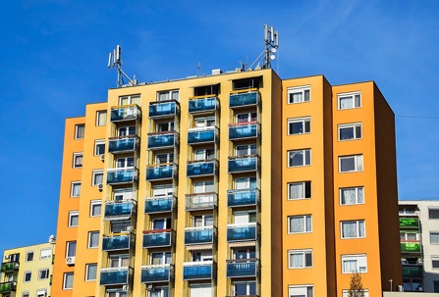

Part 2.0: Target Language
Activity 2.1: Practice
What’s this?
.
A
B
C
D
E
Notes:
2.1 What’s around Town?
Allow two minutes for this slide.
INSTRUCTIONS
Say to the Students, “Take turns asking and answering ‘What’s this?’ about each picture you see.” For example:
Student A: What’s this?
Student B: It’s a supermarket.
#1. Reveals picture A (supermarket)
#2. Reveals picture B (library)
#3. Reveals picture C (café or restaurant)
#4. Reveals picture D (apartment building)
#5. Reveals picture E (park)

Slide 8



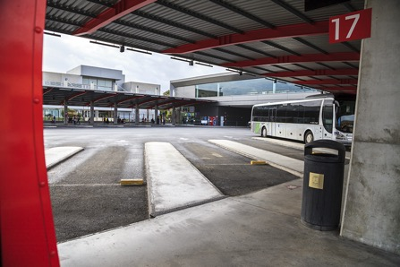
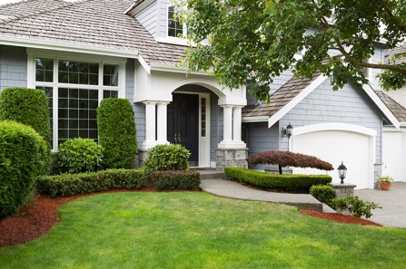
Part 2.0: Target Language
Activity 2.1: Practice
What’s this?
.
A
B
C
D
E
Notes:
2.1 What’s around Town?
Allow one to two minutes for this slide.
INSTRUCTIONS
The Students continue asking and answering “What’s this?” in the same way.
#1. Reveals picture A (apartment or home)
#2. Reveals picture B (drug store/pharmacy)
#3. Reveals picture C (office)
#4. Reveals picture D (bus station)
#5. Reveals picture E (house or home)

Slide 9
Part 2.0: Target Language
Activity 2.1: Extension
?
.
A
B
C
D
E
Notes:
2.1 What’s around Town?
Optional Extension
INSTRUCTIONS
Have the Students talk with their classmates, asking various questions about the places in the pictures. For example,
Where is… ?
How often do you go to…?
#1. Reveals picture A (house or home)
#2. Reveals picture B (café or restaurant)
#3. Reveals picture C (library)
#4. Reveals picture D (office)
#5. Reveals picture E (park)
The Students should answer the questions with full sentences.

Slide 10
Part 2.0: Target Language
Activity 2.1: Extension
?
.
A
B
C
D
E
Notes:
2.1 What’s around Town?
Optional Extension
INSTRUCTIONS
Have the Students talk with their classmates, asking various questions about the places in the pictures. For example,
Where is… ?
How often do you go to…?
#1. Picture A (apartment or home)
#2. Picture B (bus station)
#3. Picture C (apartment building)
#4. Picture D (drug store/pharmacy)
#5. Picture E (supermarket)
The Students should answer the questions with full sentences.

Slide 11
Part 2.0: Target Language
Activity 2.1: Feedback
Student 1
Student 2
Student 3
Student 4
Great job!
Great job!
Great job!
Great job!
Well done
Well done
Well done
Well done
Good try
Good try
Good try
Good try
More practice
More practice
More practice
More practice
Feedback
Notes:
2.1 What’s around Town?
FEEDBACK
Quickly give the Students feedback on the target language they just practiced.
Remind them of other resources they can take advantage of to improve their English:
Go to Wall Street World to practice grammar and vocabulary.
Review the Student Manual or Digital Book to study grammar and vocabulary.
Attend Complementary Classes to practice using grammar and vocabulary.
Join Social Clubs to practice speaking skills.

Slide 12
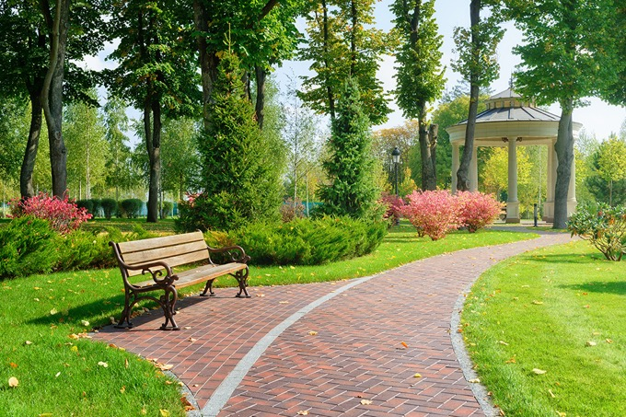
Part 2.0: Target Language
Activity 2.2: Context Creation
Go out the front door and make a right. Turn left at the first street…
How do you get to a park from where you are?
Notes:
2.2 How Do I Get There? (10 min)
Allow one minute for this slide.
OBJECTIVE
Can use basic language related to using a map (destination; Go over…; Go straight; Go two blocks; Turn right/left; Turn right/left on Bank Street; Walk across…; Walk along …)
INSTRUCTIONS
#1. Have a Student read the question. [How do you get to a park from where you are?]
#2. Encourage the Students to answer, based on their own personal locations.
#3. Reveal the sample answer. [Go out the front door and make a right. Turn left at the first street...]

Slide 13

Part 2.0: Target Language
Activity 2.2: Concept Check
How do you get to a supermarket from where you are?
Notes:
2.2 How Do I Get There?
Allow one minute for this slide.
INSTRUCTIONS
#1. Have a Student read the question. [How do you get to a supermarket from where you are?]
#2. Encourage the Students to answer, based on their own personal locations.
TEACHING TIP
Elicit target language from each Student.

Slide 14
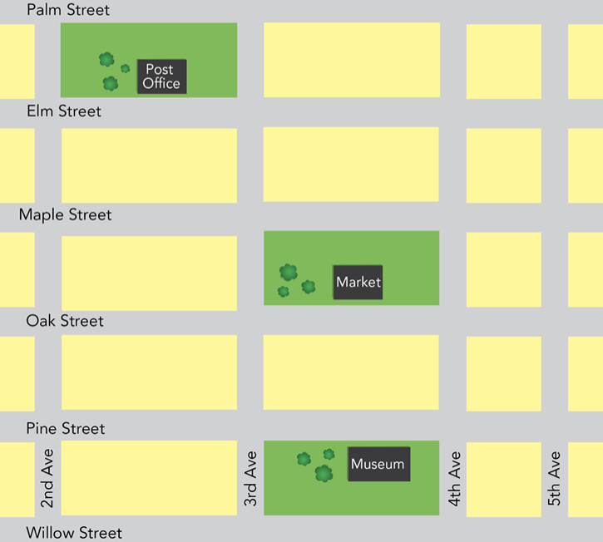
Part 2.0: Target Language
Activity 2.2: Practice
Tell your classmates how to get to these places:
The museum
The market
The post office
You Are Here
Notes:
2.2 How Do I Get There?
Allow four minutes for this slide.
INSTRUCTIONS
Tell the Students they are at the point indicated by the red arrow on the map.
#1. One Student begins by choosing one of the locations listed to the right of the map. Without telling his/her classmates what it is, the Student gives directions from the red star to that location.
When that Student is finished giving directions, his/her classmates take turns saying where they ended up. The Student who gave the directions should say whether his/her classmates ended up where s/he was trying to direct them.
Continue until each Student has a turn giving directions.

Slide 15
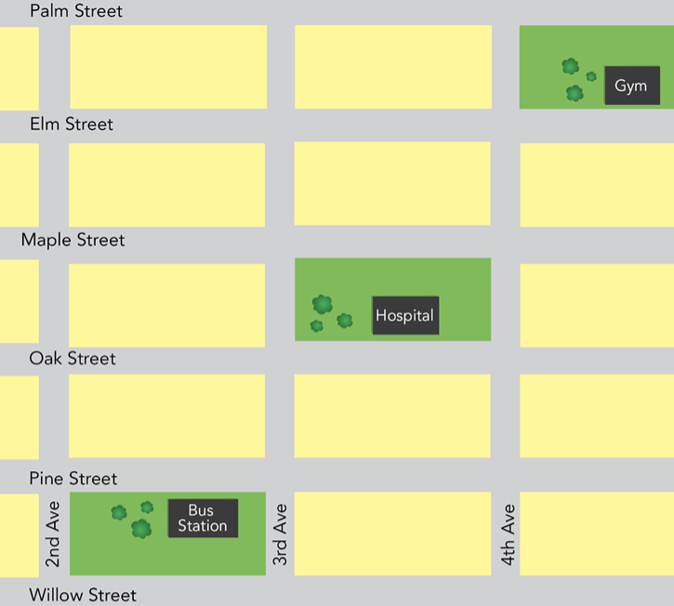
Part 2.0: Target Language
Activity 2.2: Practice
Tell your classmates how to get to these places:
The gym
The hospital
The bus station
You Are Here
Notes:
2.2 How Do I Get There?
Allow four minutes for this slide.
INSTRUCTIONS
Tell the Students they are at the point indicated by the red arrow on the map.
#1. One Student begins by choosing one of the locations listed to the left of the map. Without telling his/her classmates what it is, the Student gives directions from the red star to that location.
When that Student is finished giving directions, his/her classmates take turns saying where they ended up. The Student who gave the directions should say whether his/her classmates ended up where s/he was trying to direct them.
Continue until each Student has taken a turn giving directions.

Slide 16

Part 2.0: Target Language
Activity 2.2: Extension
Notes:
2.2 How Do I Get There?
Optional Extension
INSTRUCTIONS
Ask each Student for the best ways to get to some popular sights in their city.

Slide 17
Part 2.0: Target Language
Activity 2.2: Feedback
Student 1
Student 2
Student 3
Student 4
Great job!
Great job!
Great job!
Great job!
Well done
Well done
Well done
Well done
Good try
Good try
Good try
Good try
More practice
More practice
More practice
More practice
Feedback
Notes:
2.2 How Do I Get There?
FEEDBACK
Quickly give the Students feedback on the target language they just practiced.
Remind them of other resources they can take advantage of to improve their English:
Go to Wall Street World to practice grammar and vocabulary.
Review the Student Manual or Digital Book to study grammar and vocabulary.
Attend Complementary Classes to practice using grammar and vocabulary.
Join Social Clubs to practice speaking skills.

Slide 18

Part 3.0: Target Structures
Activity 3.1: Context Creation
Your plan is to go to the museum. What do we say when we have a plan to do something?
How can we ask a question about someone’s plan to go to the museum?
?
go to the museum
.
?
I’m going to go to the museum
Are you going to go to the museum
Notes:
3.1 What Are You Going to Do? (5 min)
Allow one minute for this slide.
OBJECTIVE
Can express basic personal intentions using going to (My boss is going to hire new people for the restaurant.)
INSTRUCTIONS
Draw the Students’ attention to the image and the cue words. [go to the museum]
#1. Have a Student read the statement and question. [Your plan is to go to the museum. What do we say when we have a plan to do something?]
#2. Encourage the Students to answer.
#3. Reveal the answer. [I’m going to go to the museum.]
#4. Draw the Students’ attention to the question mark following “go to the museum.”
#5. Have a Student read the question. [How can we ask a question about someone’s plan to go to the museum?]
#6. Encourage the Students to answer.
#7. Reveal the answer. [Are you going to go to the museum?]
TEACHING TIPS
Elicit examples of the target structure(s).
Elicit from each Student.
It helps to board elicited language.

Slide 19
Part 3.0: Target Structures
Activity 3.1: Concept Check
When does “going to the museum” happen?
later
go to the museum
tomorrow
Notes:
3.1 What Are You Going to Do?
Allow one minute for this slide.
INSTRUCTIONS
#1. Have a Student read the question. [When does “going to the museum” happen?]
#3. Encourage the Students to answer. Make sure the Students respond with a future time adverbial like “tomorrow,” “later,” etc.
#4. Reveal the sample answers. [tomorrow/later]
TEACHING TIP
Elicit target language from each Student.

Slide 20

Part 3.0: Target Structures
Activity 3.1: Practice
go to the supermarket
watch a movie
take the bus to work
talk to your parents
eat at a restaurant
do exercise at the gym
meet your friends
walk in a park
Notes:
3.1 What Are You Going to Do?
Allow three minutes for this slide.
INSTRUCTIONS
The Students have to take turns asking their classmates about their plans using the prompts on the screen. Tell the Students, “Talk about plans with your partner. You should ask and answer questions and say when you plan to do the things.”
Encourage the Students to use full sentences with both their questions and their answers. Also, encourage them to use Future Time Adverbials. For example,
Student A: Are you going to go to the supermarket (after work)?
Student B: Yes, I’m going to go to the supermarket (after work).
Student B: Are you going to watch a movie (this weekend)?
Student A: No, I’m not going to watch a movie (this weekend).
#1. go to the supermarket
#2. watch a movie
#3. take the bus to work
#4. talk to your parents
#5. eat at a restaurant
#6. do exercise at the gym
#7. meet your friends
#8. walk in a park

Slide 21

Part 3.0: Target Structures
Activity 3.1: Extension
?
You:
after this Encounter?
this weekend?
Notes:
3.1 What Are You Going to Do?
Optional Extension
INSTRUCTIONS
Ask the Students what their plans are after the Encounter. Then tell them to talk with their classmates what their plans are for the weekend.

Slide 22
Part 3.0: Target Structures
Activity 3.1: Feedback
Student 1
Student 2
Student 3
Student 4
Great job!
Great job!
Great job!
Great job!
Well done
Well done
Well done
Well done
Good try
Good try
Good try
Good try
More practice
More practice
More practice
More practice
Feedback
Notes:
3.1 What Are You Going to Do?
FEEDBACK
Quickly give the Students feedback on the target language they just practiced.
Remind them of other resources they can take advantage of to improve their English:
Go to Wall Street World to practice grammar and vocabulary.
Review the Student Manual or Digital Book to study grammar and vocabulary.
Attend Complementary Classes to practice using grammar and vocabulary.
Join Social Clubs to practice speaking skills.

Slide 23
Part 3.0: Target Structures
Activity 3.2: Context Creation
go to the museum
went to the museum
Yesterday I .
Notes:
3.2 What Did You Do Yesterday? (10 min)
Allow one minute for this slide.
OBJECTIVE
Can talk about past events using common regular/irregular past simple forms (The employee listened to the Big Boss talk.)
INSTRUCTIONS
#1. Draw the Students’ attention to the image of the museum and the cue words. [go to the museum]
#2. Have the Students read the text, filling in the blank to complete the statement.
#3. Reveal the answer. [Yesterday I went to the museum.]
Ask the Students, “Are you at the museum now?” (no)
TEACHING TIPS
Elicit examples of the target structure(s).
Elicit from each Student.
It helps to board elicited language.

Slide 24
Part 3.0: Target Structures
Activity 3.2: Context Creation
go to the museum
?
Did you go to the museum yesterday
?
What did you do yesterday
?
Notes:
3.2 What Did You Do Yesterday?
Allow one minute for this slide.
INSTRUCTIONS
#1. Draw the Students’ attention to the question mark following “go to the museum.”
#2. Ask the Students, “How can we make a question that gets ‘I went to the museum’ as the answer?” and encourage them to make the question.
#3. Reveal the sample answers. [Did you go to the museum yesterday?/What did you do yesterday?]
TEACHING TIPS
Elicit examples of the target structure(s).
Elicit from each Student.
It helps to board elicited language.

Slide 25

Part 3.0: Target Structures
Activity 3.2: Concept Check
What are some more words like “yesterday” that we use for past times after words like “went”?
Notes:
3.2 What Did You Do Yesterday?
Allow one minute for this slide.
INSTRUCTIONS
#1. Have a Student read the question. [What are some more words like “yesterday” that we use for past times after words like “went”?]
Elicit Past Time Adverbials. For example,
last week
three days ago
TEACHING TIP
Elicit target language from each Student.

Slide 26

Part 3.0: Target Structures
Activity 3.2: Practice
go to the supermarket
watch a movie
take the bus to work
talk to your parents
eat at a restaurant
do exercise at the gym
meet your friends
walk in a park
Notes:
3.2 What Did You Do Yesterday?
Allow seven minutes for this slide.
INSTRUCTIONS
Draw the Students’ attention to the cues on the screen. This time the Students will take turns asking their classmates about their past activities using the prompts on the screen. Say, “Ask and answer questions again. This time you should talk about when you did the things. Ask your classmates some questions about their answers.”
Encourage the Students to use full sentences with both their questions and their answers. Also, encourage them to use Past Time Adverbials. For example,
Student A: Did you go to the supermarket yesterday?
Student B: Yes, I went to the supermarket yesterday.
Student B: Did you watch a movie last week?
Student A: Yes, I watched a movie last week.
#1. go to the supermarket
#2. watch a movie
#3. take the bus to work
#4. talk to your parents
#5. eat at a restaurant
#6. do exercise at the gym
#7. meet your friends
#8. walk in a park
TEACHING TIP
Encourage the Students to ask follow up questions for their discussion. For example,
B: Did you watch a movie last week?
A: Yes, I watched a movie last week.
B: What movie did you watch?
A: I watched…
B: Did you like it?

Slide 27
Part 3.0: Target Structures
Activity 3.2: Feedback
Student 1
Student 2
Student 3
Student 4
Great job!
Great job!
Great job!
Great job!
Well done
Well done
Well done
Well done
Good try
Good try
Good try
Good try
More practice
More practice
More practice
More practice
Feedback
Notes:
3.2 What Did You Do Yesterday?
FEEDBACK
Quickly give the Students feedback on the target language they just practiced.
Remind them of other resources they can take advantage of to improve their English:
Go to Wall Street World to practice grammar and vocabulary.
Review the Student Manual or Digital Book to study grammar and vocabulary.
Attend Complementary Classes to practice using grammar and vocabulary.
Join Social Clubs to practice speaking skills.

Slide 28

Part 4.0: Communication
Activity 4.1: Context Creation
last week
next week
?
?
When did you go to the game
What did you do last week
I went to a basketball game. Ask me when I went to the game.
.
I went on Sunday
Ask me a question about last week.
?
Did you play tennis last week
Notes:
4.1 What Are Your Plans? (10 min)
Allow one minute for this slide.
OBJECTIVES
Can talk about past events using common regular/irregular past simple forms (The employee listened to the Big Boss talk.)
Can express basic personal intentions using going to (My boss is going to hire new people for the restaurant.)
Can express basic intentions with simple time markers (I am going to make soup today.)
INSTRUCTIONS
#1. Draw the Students’ attention to the cue words. [last week/next week]
#2. Have a Student read the statement. [Ask me a question about last week.]
#3. Encourage the Students to answer.
#4. Reveal the sample answers. [What did you do last week?/Did you play tennis last week?]
#5. Have a Student read the statement. [I went to a basketball game. Ask me when I went to the game.]
#6. Encourage the Students to answer.
#7. Reveal the answer. [When did you go to the game?]
#8. Encourage the Students to answer.
#9. Reveal the sample answer. [I went on Sunday.]
TEACHING TIPS
Brainstorm/Elicit a variety of the target language, which will be used and assessed during the practice.
Elicit from each Student.
It helps to board elicited language.

Slide 29
Part 4.0: Communication
Activity 4.1: Context Creation
last week
next week
?
What are you going to do next week
Ask me a question about next week.
I’m going to a football game. Ask me when.
I’m going to go on Wednesday.
?
When are you going to a football game
Notes:
4.1 What Are Your Plans?
Allow one minute for this slide.
INSTRUCTIONS
#1. Have a Student read the statement. [Ask me a question about next week.]
#2. Encourage the Students to answer.
#3. Reveal the first sample answer. [What are you going to do next week?] Also accept an answer such as “Are you going to play tennis next week?”
#4. Have a Student read the statements. [I’m going to a football game. Ask me when.]
#5. Encourage the Students to form the corresponding question.
#6. Reveal the answer. [When are you going to a football game?]
#7. Have a Student read the response. [I’m going to go on Wednesday.]
TEACHING TIPS
Brainstorm/Elicit a variety of the target language, which will be used and assessed during the practice.
Elicit from each Student.
It helps to board elicited language.

Slide 30
Part 4.0: Communication
Activity 4.1: Practice
Student A
Monday | Tuesday | Wednesday | Thursday | Friday | Saturday | Sunday
library | school | office | restaurant | post office | supermarket | park
office | post office | hospital | school | library | supermarket | restaurant
Last Week
Next Week
Student B
Monday | Tuesday | Wednesday | Thursday | Friday | Saturday | Sunday
office | library | school | hospital | post office | restaurant | park
school | restaurant | office | park | library | post office | supermarket
Last Week
Last Week
Next Week
Notes:
4.1 What Are Your Plans?
Allow four minutes for this slide.
INSTRUCTIONS
Tell the Students who is Student A and who is Student B.
Direct the Students’ attention to the schedules.
#1. Reveal the arrows pointing towards last week. Say, ”This is what you did last week.”
#2. Reveal the arrows pointing towards next week. Say, “These are your plans for next week.”
Say, “Ask each other questions about your schedules this week and next week. See if you did or are going to do any of the same things.” For example,
A: What did you do on Tuesday last week?
B: On Tuesday I went to the library. What did you do last Tuesday? A: I went to school. Did you go to school on Monday?
After the Students finish, ask them which days they both did the same things. Then ask what plans they share on the same days next week.
ANSWER KEY
Last week: We both went to the post office and the park on the same day (Friday and Sunday respectively).
Next week: We are both going to go to the library on Friday.

Slide 31
Part 4.0: Communication
Activity 4.1: Practice
Student C
Monday | Tuesday | Wednesday | Thursday | Friday | Saturday | Sunday
school | school | park | restaurant | post office | supermarket | library
office | school | hospital | library | library | supermarket | park
Last Week
Next Week
Student D
Monday | Tuesday | Wednesday | Thursday | Friday | Saturday | Sunday
office | school | school | hospital | park | post office | restaurant
school | restaurant | post office | library | park | office | park
Last Week
Next Week
Notes:
4.1 What Are Your Plans?
Allow four minutes for this slide.
INSTRUCTIONS
Now direct Student C and Student D’s attention to the schedules.
#1. Reveal the arrows pointing towards last week. Say, ”This is what you did last week.”
#2. Reveal the arrows pointing towards next week. Say, “These are your plans for next week.”
Say, “Ask each other questions about your schedules this week and next week. See if you did or are going to do any of the same things.”
After the Students finish, ask them which days they both did the same things. Then ask what plans they share on the same days next week.
ANSWER KEY
Last week: We both went to school on Tuesday.
Next week: We are both going to go to the park on Sunday and the library on Thursday.

Slide 32
Part 4.0: Communication
Activity 4.1: Feedback
 |  | Great job! | Well done | Good try | Need more practice
Student 1 | Range: How well you produce a range of language
 | Accuracy: How often you make mistakes
 | Quality of interaction: How well you ask and answer questions
 | Fluency and Spoken Production: How clearly you present ideas
Student 2 | Range: How well you produce a range of language
 | Accuracy: How often you make mistakes
 | Quality of interaction: How well you ask and answer questions
 | Fluency and Spoken Production: How clearly you present ideas
Student 3 | Range: How well you produce a range of language
 | Accuracy: How often you make mistakes
 | Quality of interaction: How well you ask and answer questions
 | Fluency and Spoken Production: How clearly you present ideas
Student 4 | Range: How well you produce a range of language
 | Accuracy: How often you make mistakes
 | Quality of interaction: How well you ask and answer questions
 | Fluency and Spoken Production: How clearly you present ideas
Notes:
4.1 What Are Your Plans?
FEEDBACK
Quickly give the Students feedback on the target language they just practiced.
Remind them of other resources they can take advantage of to improve their English:
Go to Wall Street World to practice grammar and vocabulary.
Review the Student Manual or Digital Book to study grammar and vocabulary.
Attend Complementary Classes to practice using grammar and vocabulary.
Join Social Clubs to practice speaking skills.

Slide 33

Part 4.0: Communication
Activity 4.2: Context Creation
?
?
How can I get to the library
Where is the library
So, you are going to go to the library next week. Imagine that you don’t know where the library is. What do you have to do?
So, you need directions. What’s a good question to ask someone?
.
Ask for directions
Notes:
4.2 Finding Where You Want to Go (10 min)
Allow one minute for this slide.
OBJECTIVES
Can name a limited range of common buildings and dwelling places (condo; hospital; library; mall; station)
Can use basic language related to using a map (destination; Go over…; Go straight; Go two blocks; Turn right/left; Turn right/left on Bank Street; Walk across…; Walk along …)
Can name very common public places in a city (drug store; hospital; library; mall; pharmacy; station)
Can ask for and give directions referring to a map or plan (Can you give me directions?)
INSTRUCTIONS
#1. Have a Student read the statements and the question. [So, you are going to go to the library next week. Imagine that you don’t know where the library is. What do you have to do?]
#2. Encourage the Students to answer.
#3. Reveal the answer. [Ask for directions.]
#4. Have a Student read the statements and the question. [So, you need directions. What’s a good question to ask someone?]
#5. Encourage the Students to answer.
#6. Reveal the sample answers. [Where is the library?/How can I get to the library?]
TEACHING TIPS
Brainstorm/Elicit a variety of the target language, which will be used and assessed during the practice.
Elicit from each Student.
It helps to board elicited language.

Slide 34
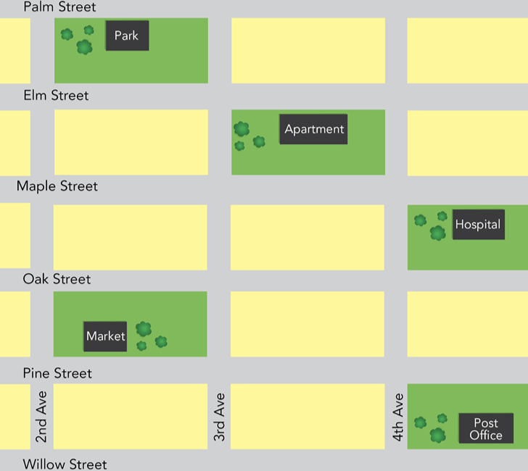
Part 4.0: Communication
Activity 4.2: Context Creation
Park
You Are Here
Notes:
4.2 Finding Where You Want to Go
Allow one minute for this slide.
INSTRUCTIONS
Draw the Students’ attention to the red arrows and say, “You are here and the park is here. Can you give me directions?”
Elicit, for example, “Go straight. Follow Pine Street a short way to 4th Avenue. Turn left and walk one block to Oak Street. Turn right and go a short distance. The park will be on your right.”
TEACHING TIPS
Alternate directions to the park are “Go straight. Follow Pine Street for one block. Then turn left on 5th Avenue. Go straight for one block to Oak Street. Turn right and go a short distance. The park will be on your right.”
Brainstorm/Elicit a variety of the target language, which will be used and assessed during the practice.
Elicit from each Student.
It helps to board elicited language.

Slide 35
Part 4.0: Communication
Activity 4.2: Practice
You want to go to these places. Listen to your classmates’ directions and find the right place on the map.
1. You live at this place.
2. You want to send mail.
3. You want to take a bus to another city at this place.
Notes:
4.2 Finding Where You Want to Go
Allow four minutes for this slide.
INSTRUCTIONS
Give the Students a moment to study the map and the instructions to the right of it.
Tell the Students they are at the red star on the map. One Student begins by choosing one of the locations in the numbered list to the right of the map. Without telling his/her classmates what it is, the Student gives directions from the red star to that location.
When that Student is finished giving directions, his/her classmates take turns saying where they ended up by saying the name of the building as well as what people do there. For example, “I’m at the apartments. I live there.”
The Student who gave the directions should say whether his/her classmates ended up where s/he was trying to take them.
Continue until each Student has taken a turn giving directions (more than one Student can choose the same destination).
ANSWER KEY
1. apartment
2. post office
3. bus station
TEACHING TIP
The task in this activity requires clear, thorough explanation. Be sure to model the first example and do a comprehension check of Students’ understanding of the task.

Slide 36
Part 4.0: Communication
Activity 4.2: Practice
You want to go to these places. Listen to your classmates’ directions and find the right place on the map.
You want to see a doctor.
You want to be outside in the trees.
You want to buy food.
Notes:
4.2 Finding Where You Want to Go
Allow four minutes for this slide.
INSTRUCTIONS
Give the Students a moment to study the map and the instructions to the right of it.
Tell the Students they are at the red star on the map. One Student begins by choosing one of the locations in the numbered list to the right of the map. Without telling his/her classmates what it is, the Student gives directions from the red point to that location.
When that Student is finished giving directions, his/her classmates take turns saying where they ended up. The Student who gave the directions should say whether his/her classmates ended up where he/she was trying to take them.
Continue until each Student has taken a turn giving directions (more than one Student can choose the same destination).
ANSWER KEY
1. hospital
2. park
3. market
TEACHING TIPS
The task in this activity requires clear, thorough explanation. Be sure to model the first example and do a comprehension check of Students’ understanding of the task.
As a extension, if Students end up in the wrong place, have them explain where they are. The explainer should then give new directions to get them to the correct location.

Slide 37
Part 4.0: Communication
Activity 4.2: Feedback
 |  | Great job! | Well done | Good try | Need more practice
Student 1 | Range: How well you produce a range of language
 | Accuracy: How often you make mistakes
 | Quality of interaction: How well you ask and answer questions
 | Fluency and Spoken Production: How clearly you present ideas
Student 2 | Range: How well you produce a range of language
 | Accuracy: How often you make mistakes
 | Quality of interaction: How well you ask and answer questions
 | Fluency and Spoken Production: How clearly you present ideas
Student 3 | Range: How well you produce a range of language
 | Accuracy: How often you make mistakes
 | Quality of interaction: How well you ask and answer questions
 | Fluency and Spoken Production: How clearly you present ideas
Student 4 | Range: How well you produce a range of language
 | Accuracy: How often you make mistakes
 | Quality of interaction: How well you ask and answer questions
 | Fluency and Spoken Production: How clearly you present ideas
Notes:
4.2 Finding Where You Want to Go
FEEDBACK
Quickly give the Students feedback on the target language they just practiced.
Remind them of other resources they can take advantage of to improve their English:
Go to Wall Street World to practice grammar and vocabulary.
Review the Student Manual or Digital Book to study grammar and vocabulary.
Attend Complementary Classes to practice using grammar and vocabulary.
Join Social Clubs to practice speaking skills.

Slide 38
Encounter 24
Overall Feedback
 |  | Great job! | Well done | Good try | Need more practice
 | Activity 2.1: What’s around Town?
 | Activity 2.2: How Do I Get There?
 | Activity 3.1: What Are You Going to Do?
 | Activity 3.2: What Did You Do Yesterday?
 | Activity 4.1: What Are Your Plans?
 | Activity 4.2: Finding Where You Want To Go
Student 1
Feedback
Notes:
OVERALL FEEDBACK (3–5 min)
Allow one minute for this slide.
Explain to the Students that you will now be giving them an overall assessment and recommendations. Use the following prompts to help you explain the assessment:
First, you did a really good job of…
The areas where you could use a little more practice are…
The language points I didn’t hear you use were...
As a result, I’d recommend that you… [continue on to Unit 25… work on (X, Y, Z ) and repeat Encounter 24].
Do you have any questions?

Slide 39
Encounter 24
Overall Feedback
 |  | Great job! | Well done | Good try | Need more practice
 | Activity 2.1: What’s around Town?
 | Activity 2.2: How Do I Get There?
 | Activity 3.1: What Are You Going to Do?
 | Activity 3.2: What Did You Do Yesterday?
 | Activity 4.1: What Are Your Plans?
 | Activity 4.2: Finding Where You Want To Go
Student 2
Feedback
Notes:
OVERALL FEEDBACK (3–5 min)
Allow one minute for this slide.
Explain to the Students that you will now be giving them an overall assessment and recommendations. Use the following prompts to help you explain the assessment:
First, you did a really good job of…
The areas where you could use a little more practice are…
The language points I didn’t hear you use were...
As a result, I’d recommend that you… [continue on to Unit 25… work on (X, Y, Z ) and repeat Encounter 24].
Do you have any questions?

Slide 40
Encounter 24
Overall Feedback
 |  | Great job! | Well done | Good try | Need more practice
 | Activity 2.1: What’s around Town?
 | Activity 2.2: How Do I Get There?
 | Activity 3.1: What Are You Going to Do?
 | Activity 3.2: What Did You Do Yesterday?
 | Activity 4.1: What Are Your Plans?
 | Activity 4.2: Finding Where You Want To Go
Student 3
Feedback
Notes:
OVERALL FEEDBACK (3–5 min)
Allow one minute for this slide.
Explain to the Students that you will now be giving them an overall assessment and recommendations. Use the following prompts to help you explain the assessment:
First, you did a really good job of…
The areas where you could use a little more practice are…
The language points I didn’t hear you use were...
As a result, I’d recommend that you… [continue on to Unit 25… work on (X, Y, Z ) and repeat Encounter 24].
Do you have any questions?

Slide 41
Encounter 24
Overall Feedback
 |  | Great job! | Well done | Good try | Need more practice
 | Activity 2.1: What’s around Town?
 | Activity 2.2: How Do I Get There?
 | Activity 3.1: What Are You Going to Do?
 | Activity 3.2: What Did You Do Yesterday?
 | Activity 4.1: What Are Your Plans?
 | Activity 4.2: Finding Where You Want To Go
Student 4
Feedback
Notes:
OVERALL FEEDBACK (3–5 min)
Allow one minute for this slide.
Explain to the Students that you will now be giving them an overall assessment and recommendations. Use the following prompts to help you explain the assessment:
First, you did a really good job of…
The areas where you could use a little more practice are…
The language points I didn’t hear you use were...
As a result, I’d recommend that you… [continue on to Unit 25… work on (X, Y, Z ) and repeat Encounter 24].
Do you have any questions?

Slide 42

Part 5.0: Wrap-Up
.
.
Notes:
Activity 5.1 Sentence Chain (5 min)
Allow five minutes for this slide.
OBJECTIVE
• To review and practice target language from the Unit
INSTRUCTIONS
Tell the Students your plans for the weekend. Then ask a Student, “What are you going to do this weekend?”
Have that Student answer, saying what you are doing as well. For example,
(Teacher’s name) is going to play golf, and I’m going to play basketball.
Instruct the Students to continue with the chain and, if possible, you can engage in the activity with the Students. Once the chain breaks, switch the theme to the past tense, and then to directions.

Slide 43

Thank you for coming.
We hope you enjoyed the class.
Don’t forget
to leave feedback!
Teacher
Class was fun
Instructions were clear
«««««
«««««
«««««
«««««
«««««
«««««

Slide 44
© 2017 by Pearson Education Limited All rights reserved.
No part of this publication may be reproduced, stored in a retrieval system, or transmitted in any form or by any means, electronic, mechanical, photocopying, recording or otherwise without the permission of the Publishers.
This material is the intellectual property of Pearson Education Limited.
Image Credits:
Monkey Business/Fotolia; ilolab/Fotolia; Minerva Studio/Fotolia; Mny-Jhee/Fotolia; viperagp/Fotolia; slavun/Fotolia; william87/Fotolia; jozik13/Fotolia; tab62/Fotolia; majorosl66/Fotolia; ZaZa studio/Fotolia; Warren Goldswain/Fotolia; polygraphus/Fotolia; smuki/Fotolia; AstroBoi/Fotolia; Oleksiy Mark/Fotolia; golubovy/Fotolia; Topanga/Fotolia; BlueSkyImages/Fotolia; Kaspars Grinvalds; Oleksiy Mark/Fotolia; AstroBoi/Fotolia; golubovy/Fotolia; polygraphus/Fotolia; Warren Goldswain/Fotolia; Topanga/Fotolia; ZaZa studio/Fotolia; smuki/Fotolia; smuki/Fotolia; ZaZa studio/Fotolia; Kaspars Grinvalds; Kaspars Grinvalds; BlueSkyImages/Fotolia; BlueSkyImages/Fotolia; BlueSkyImages/Fotolia; AstroBoi/Fotolia; polygraphus/Fotolia; polygraphus/Fotolia; polygraphus/Fotolia; Kaspars Grinvalds; BlueSkyImages/Fotolia

